Slide 1
Promotion Bump Case
Emre Kaan Yılmaz

Slide 2
Part A

Slide 3
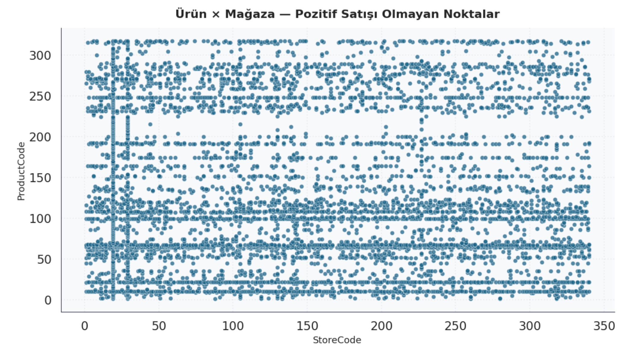
Criteria of Separation 1: Neglecting Stock Problem
Some products haven’t been sold in some stores. That may cause from stock, setup problems, etc. That should not affect our categorization.

Slide 4
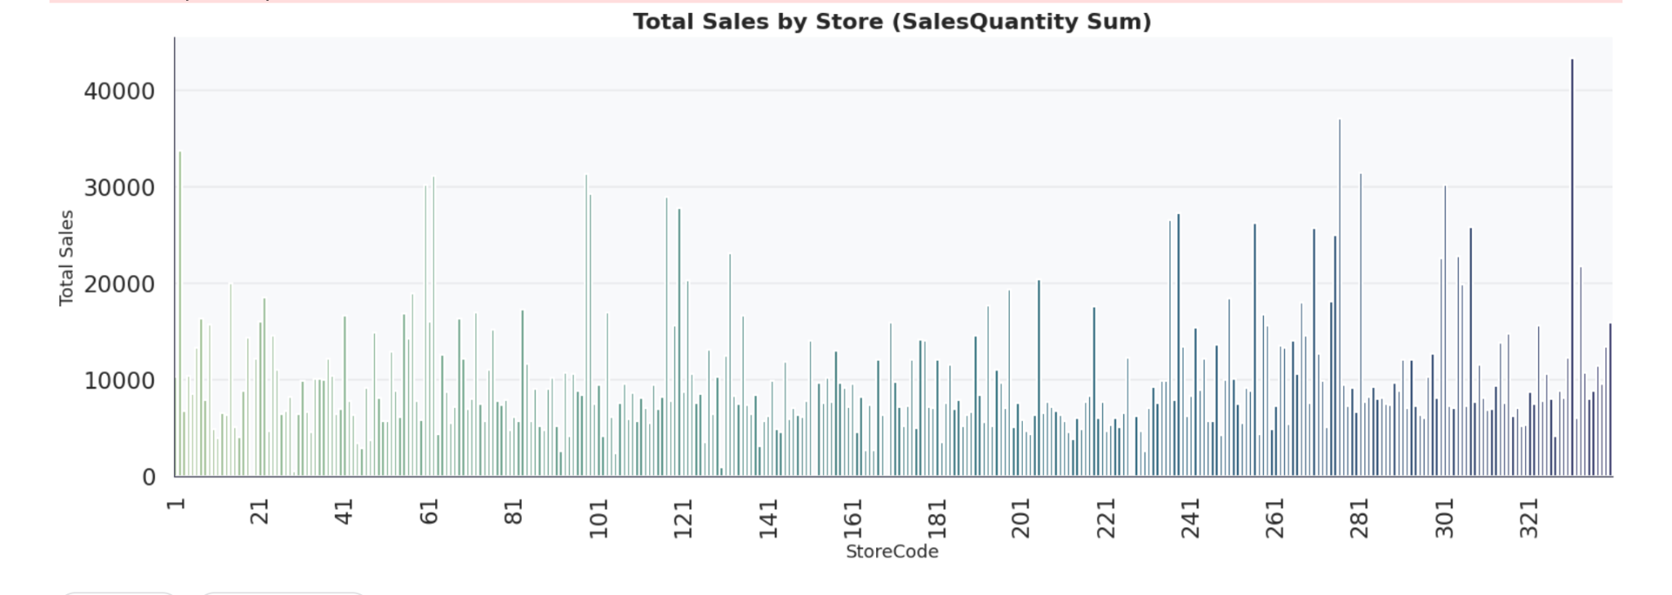
Criteria of Separation 2: Individual Unit Performance
Stores have different sale performance.
Items have different performance across stores.

Slide 5
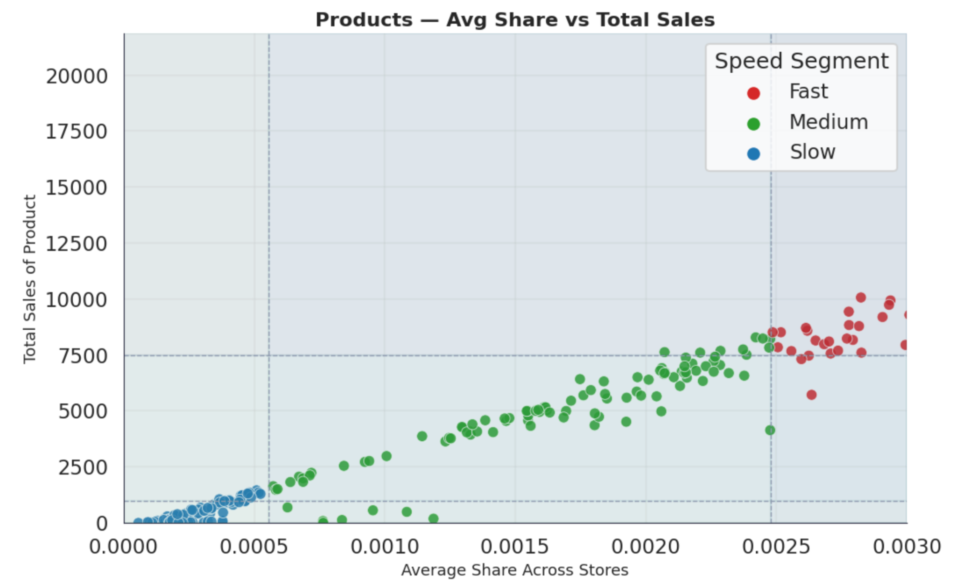
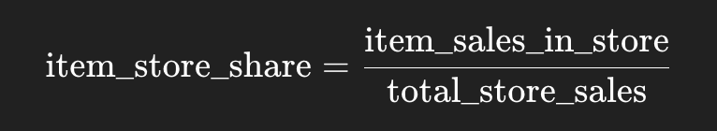
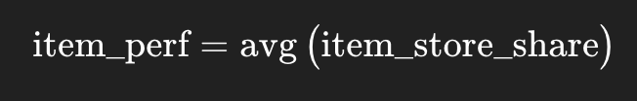
Method of Clustering: Items
Find performance at the store.
If the store and item pair has no recorded sales, make the performance null for that pair.
Get average of the performance (null values automatically will be neglected)

Slide 6
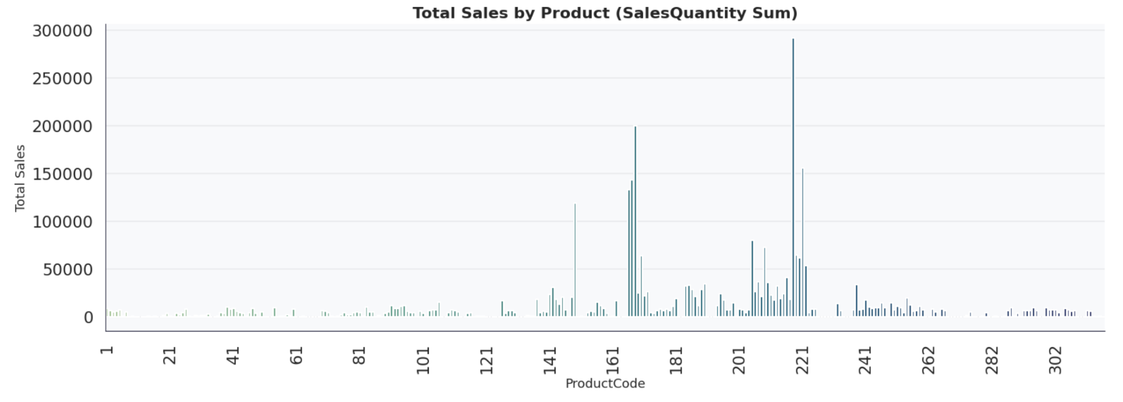
Criteria of Separation 2: Individual Unit Performance
Items have different sale performance.
Stores have different performance for different items.

Slide 7
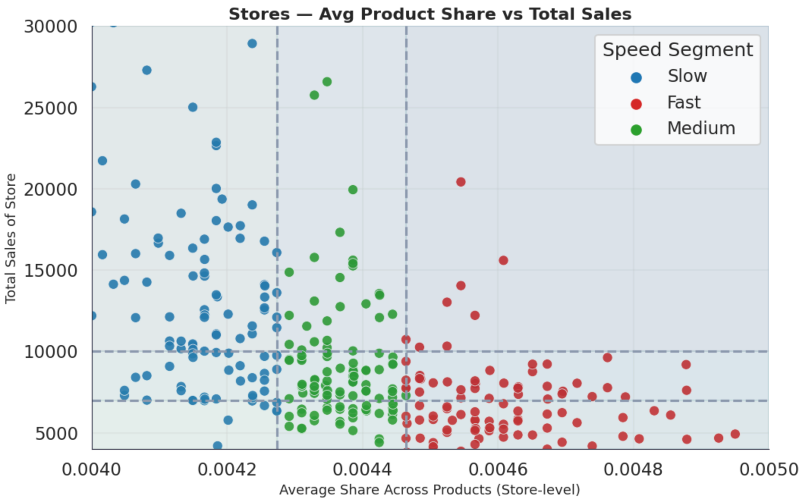
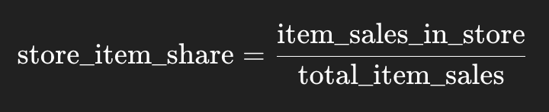
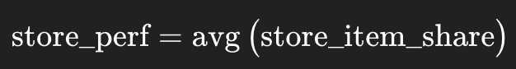
Method of Clustering: Stores
Find performance for the Item. (Sales of the Item In the Store) / (Total Item Sales)
If the store and item pair has no recorded sales, make the performance null for that pair.
Get average of the performance (null values automatically will be neglected)

Slide 8
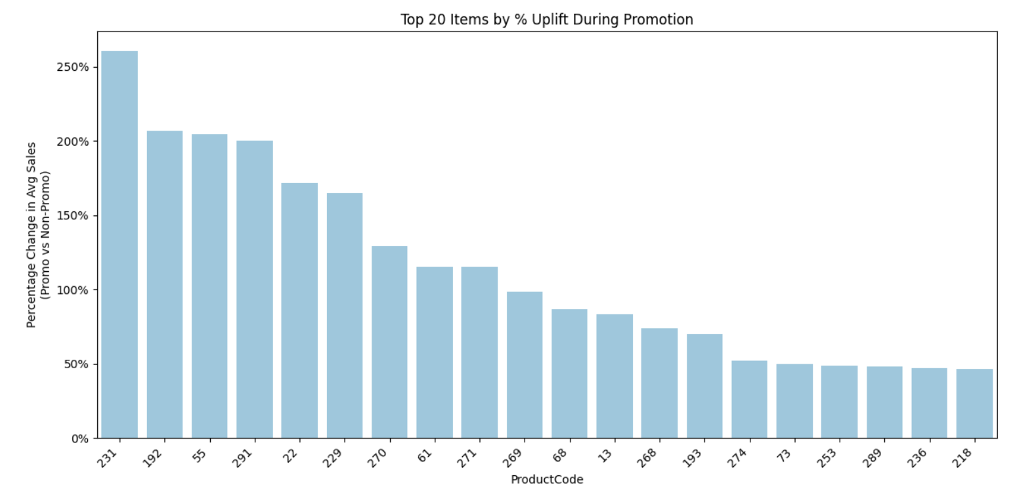
Items Experiencing Biggest Sale Increase In the Promotion
Looking at the average with assumptions

Slide 9
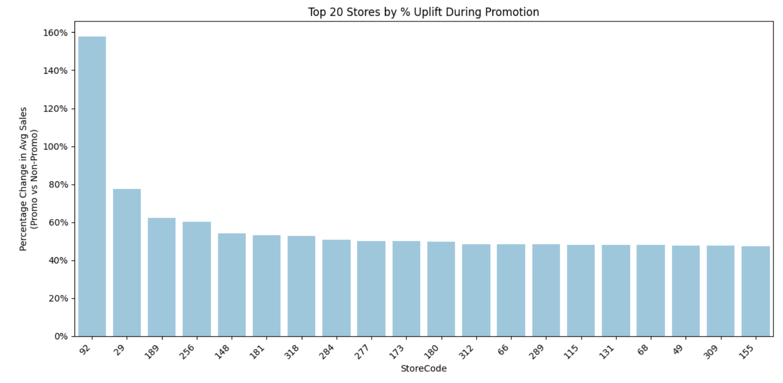
Stores Experiencing Biggest Sale Increase In the Promotion
Looking at the average with assumptions

Slide 10
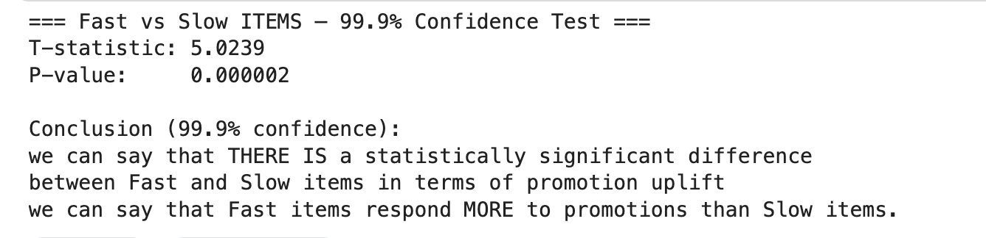
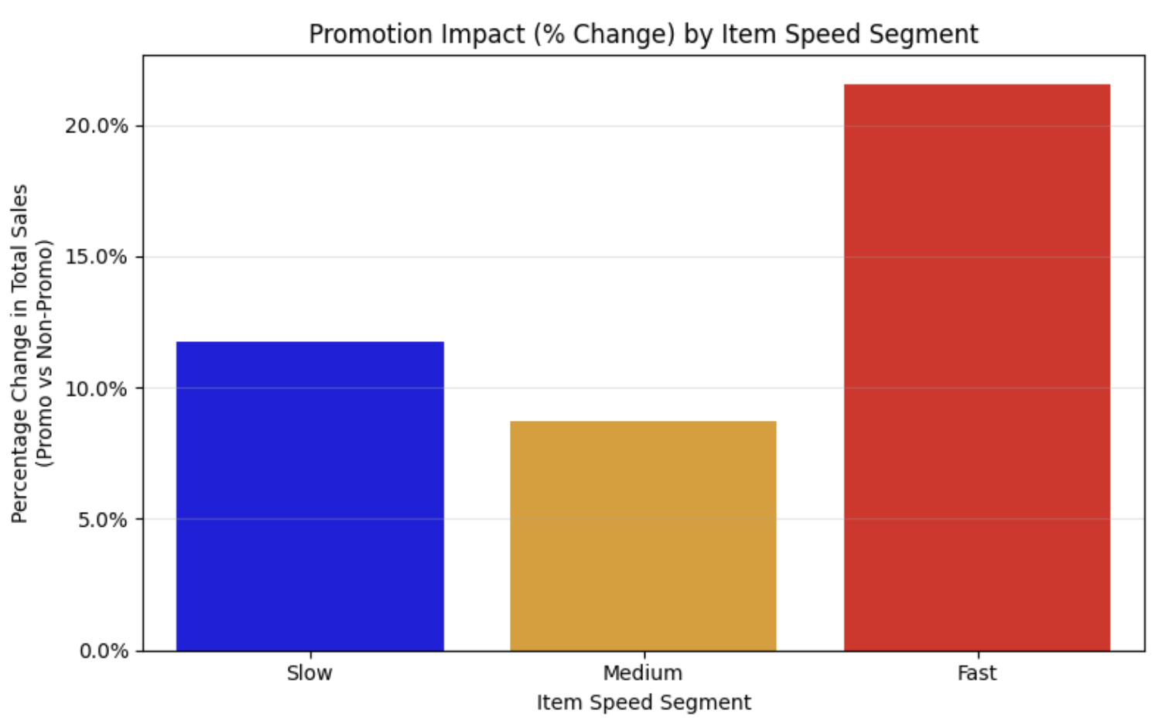
Sales for Slow vs. Fast Items

Slide 11
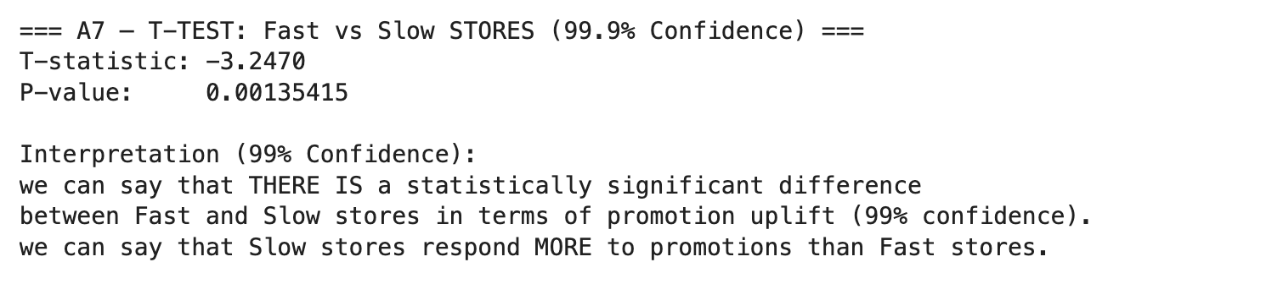
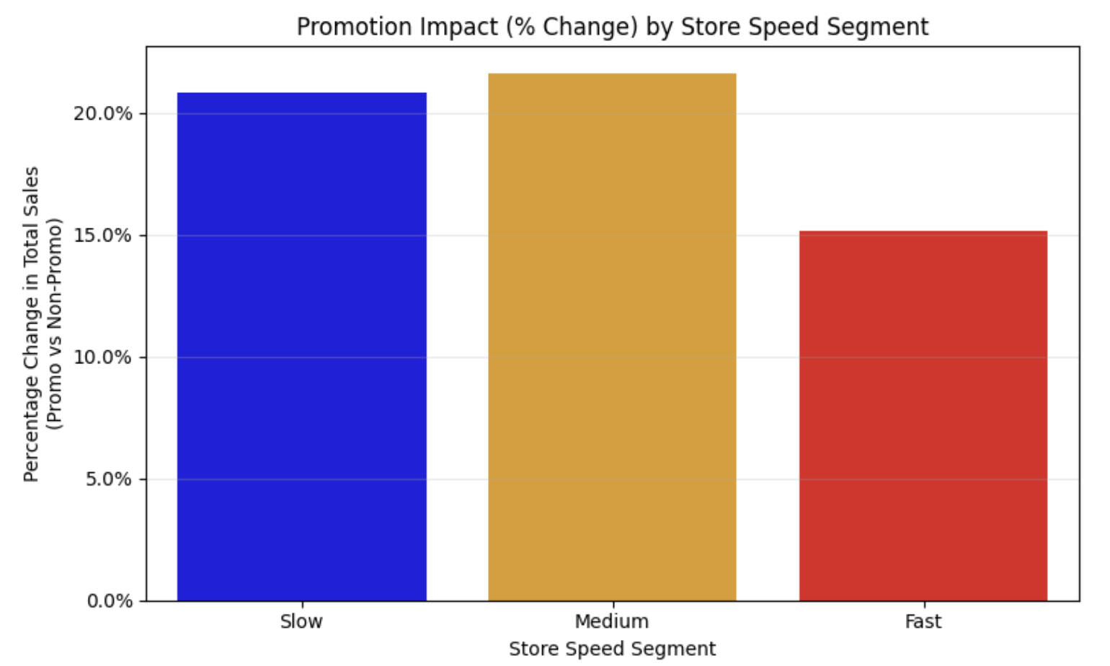
Sales for Slow vs. Fast Stores

Slide 12
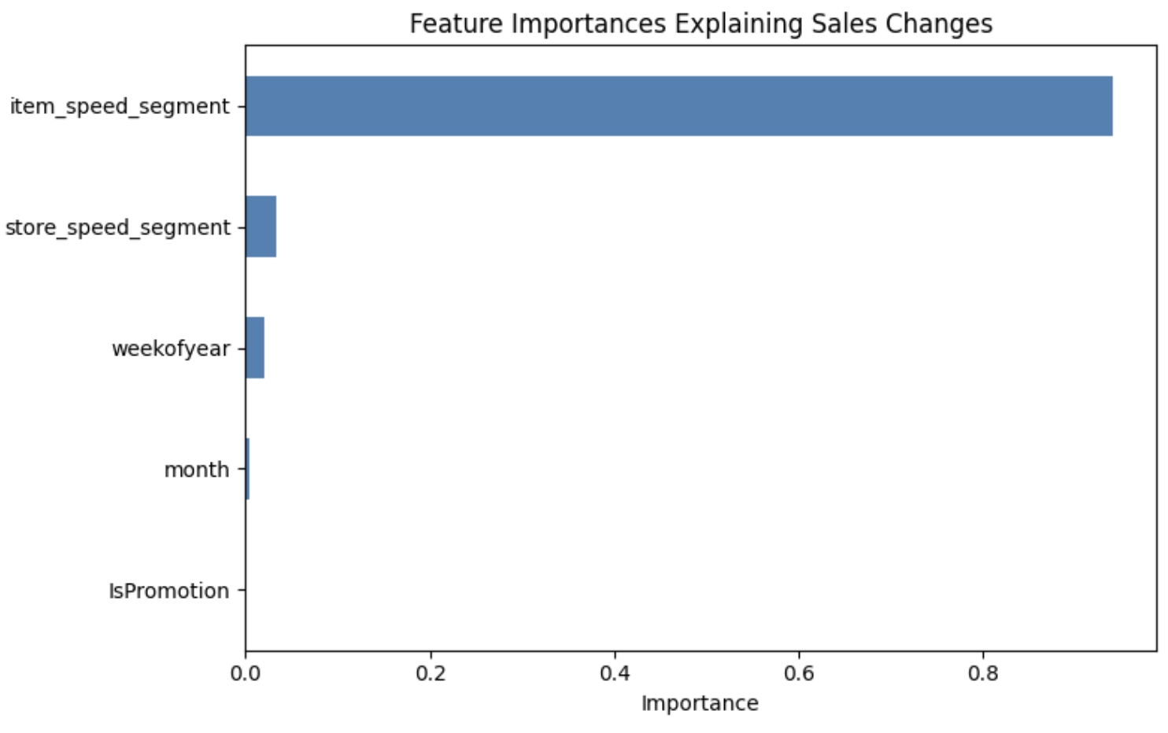
Random Forest: Feature Importance for Sales

Slide 13
Part B

Slide 14
Goodness of Fit
RMSE: highly effective for capturing large prediction gaps, especially during promotion periods where sales volatility is higher
MAPE: Easily Interpretable

Slide 15
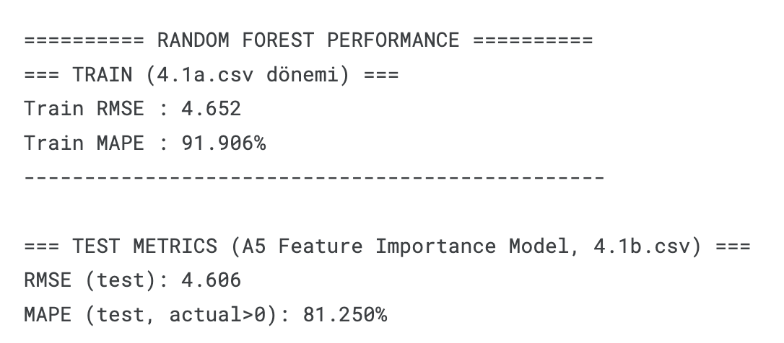
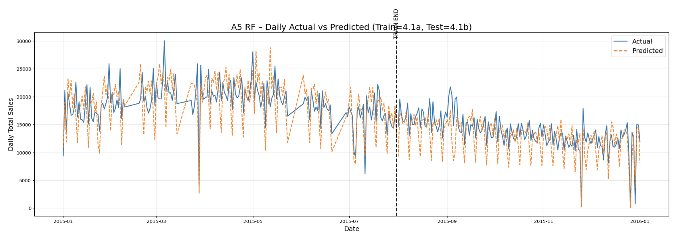
Model Performance
Underfitting: can be improved for both training and test.
Not enough complexities learned by the model

Slide 16
What can be improved?
Feature engineering
More feature engineering. ( Add Lagged, Rolling, Statistical, Logarithmic, Seasonal values)
Add store performance feature. (store specific sale /total sale of item)
Add item performance feature. (item specific sale / total sale of store)
Add avg performance of store feature
Add avg performance of item feature
Data
Add item category feature
Data cleaning (Make null handling, outlier check, etc. )
Model
Validation and hyperparameter optimization
Advanced models for better fit: Catboost
Multi algorithm for better fit + Voting regressor

Slide 17
Recommendations
Consider item, store and itemxstore promotions as promotions are more effective in Fast Items and Slow stores.
Consider involving profit in the whole project because aim is to maximize profit. (cost, price, promotion scope)

Slide 18
Bonus

Slide 19
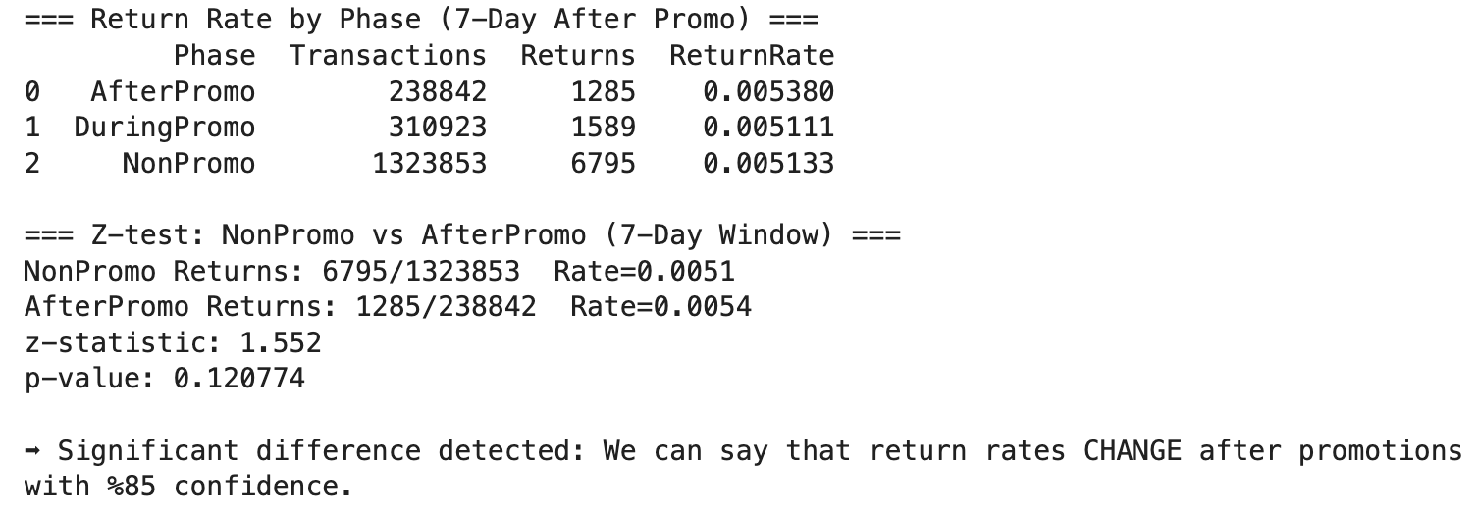
Return Rates After Promotion
Assumption: we can only measure returns if there is minus sale amount. We do not consider ghost returns that are not deducted from sales. There is no information about that in the data.

Slide 20
Final Model

Slide 21
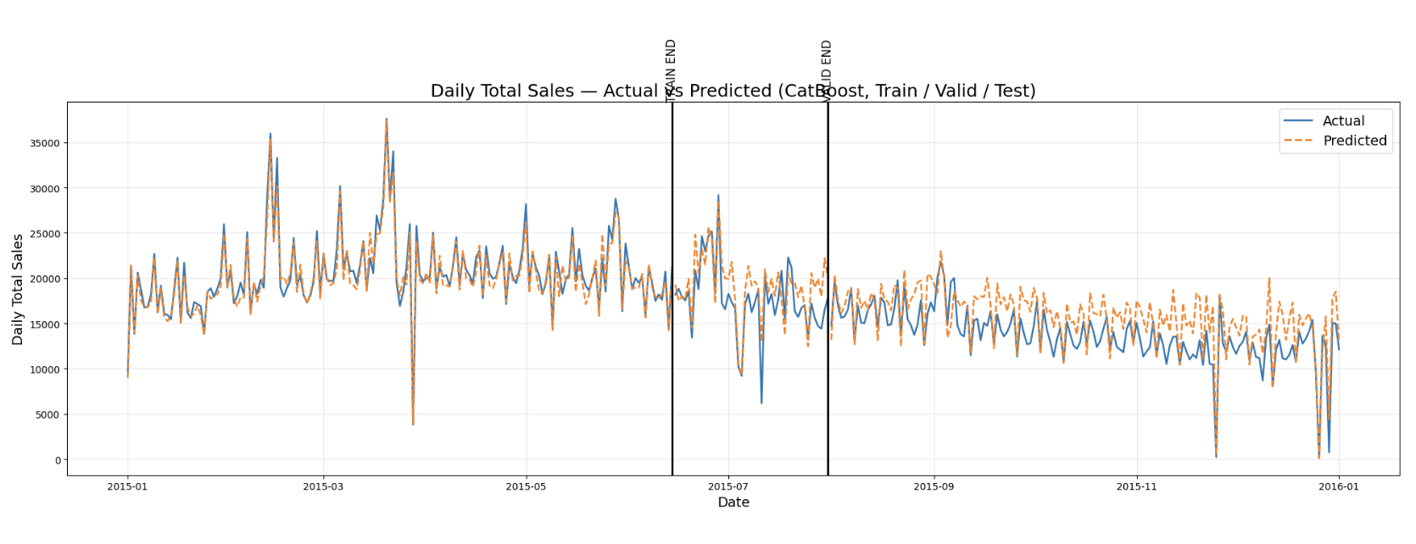
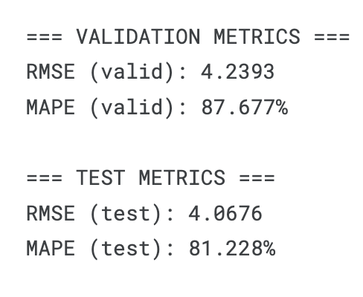
Catboost

Slide 22
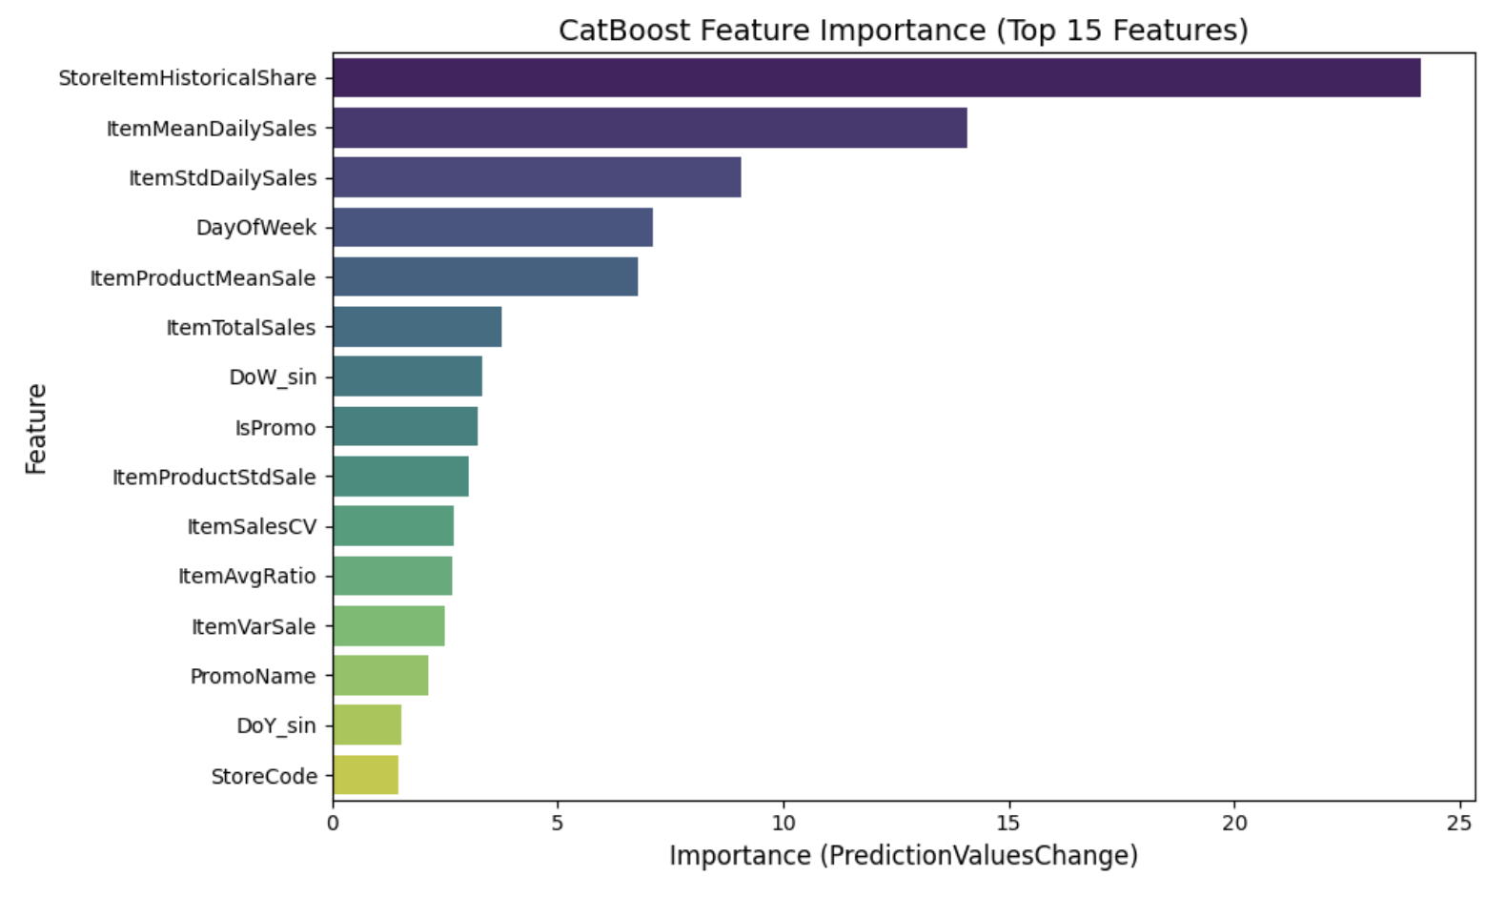
Next Steps
Simplify model by eliminating unimportant features
Combine with other models by using voting regressor

